Slide 1
Weather Data Analysis & Forecasting
A Comprehensive Study Using Machine Learning Models

Slide 2
Objectives
Dive into weather data to discover meaningful patterns and trends.
Develop and assess forecasting models to predict weather with precision.
Conduct in-depth climate and geographical analyses to gain unique insights.
Identify the most important factors that influence temperature variations.
Choose the most reliable and accurate model for weather forecasting

Slide 3
Data Cleaning and Preprocessing
Filled in missing values with smart techniques to maintain data accuracy.
Identified extreme values (outliers) and adjusted them using the IQR method to ensure clean data.
Scaled numerical data for consistency, so all features were on the same playing field.
Converted timestamp data into readable datetime format to prepare it for time-series analysis.
Tools Used: Pandas and NumPy – the go-to tools for data manipulation and preparation.

Slide 4
Exploratory Data Analysis (EDA)
Climate Analysis: Conducted climate analysis to study temperature variations across regions.
Spatial Patterns: Visualized spatial patterns using scatter plots to map temperature across latitude and longitude.
Environmental Impact: Analyzed the environmental impact by correlating temperature with air quality parameters (e.g., PM2.5, CO) and uncovering trends through pair plots.

Slide 5
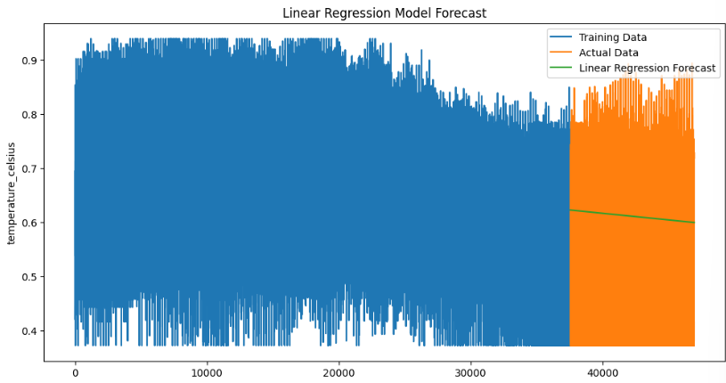
Linear Regression Model forecast

Slide 6
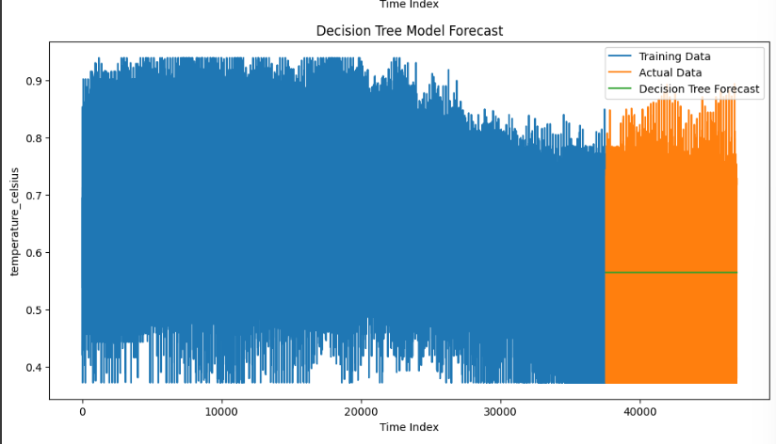
DECISION TREE MODEL FORECAST

Slide 7
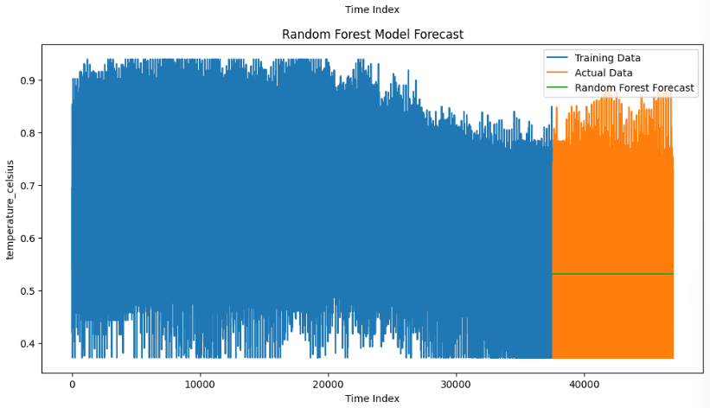
RANDOM FOREST MODEL FORECAST

Slide 8
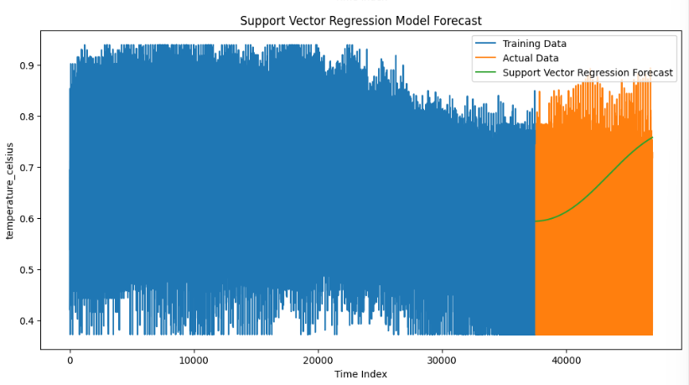
SUPPORT VECTOR REGRESSION MODEL FORECAST

Slide 9
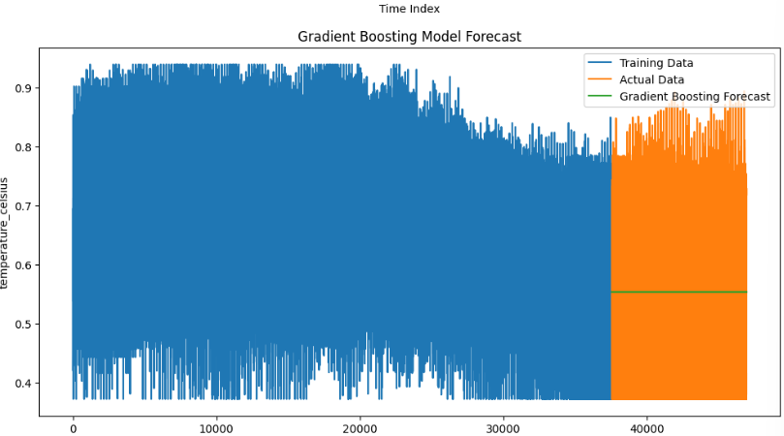
GRADIENT BOOSTING MODEL FORECAST

Slide 10
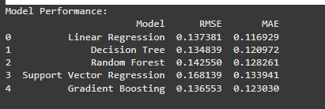
REGRESSOR MODELS COMPARISION:

Slide 11
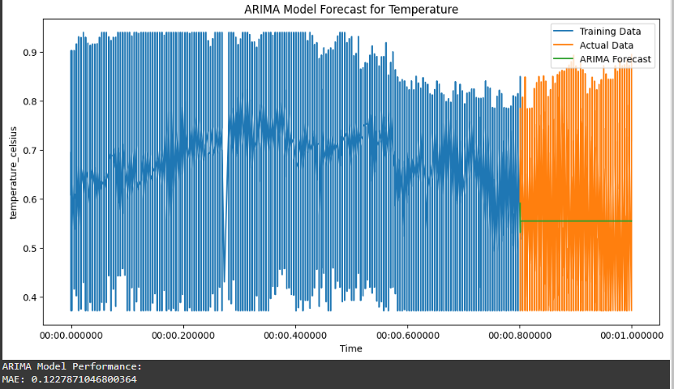
ARIMA MODEL

Slide 12
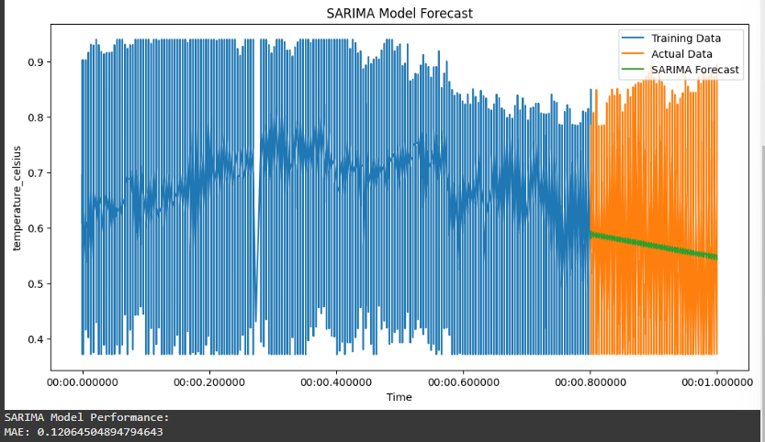
SARIMA MODEL

Slide 13
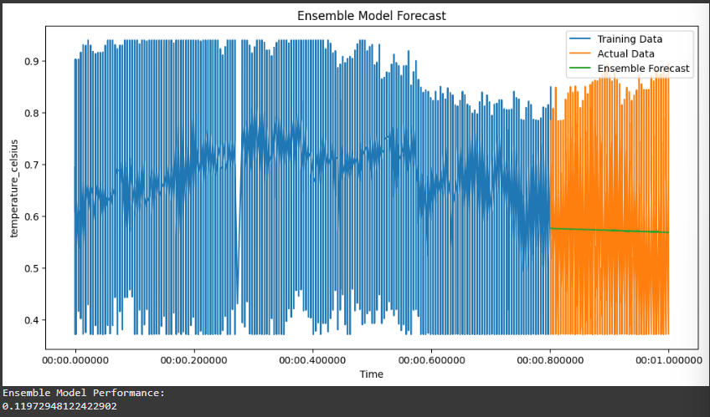
ENSEMBLE TECHNIQUES

Slide 14
COMPARISION BETWEEN MODELS
Linear Regression: Delivered the best accuracy with the lowest MAE (0.1162), making it the most reliable and efficient model
for this dataset.
SARIMA: Showed strong performance with an MAE of 0.12, well-suited for data exhibiting seasonal trends.
Ensemble Model: Integrated predictions from multiple models, achieving an MAE of0.119, providing robustness but slightly
less precision than Linear Regression.
ARIMA: Recorded the highest MAE (0.122), indicating it was the least effective model for this dataset.

Slide 15
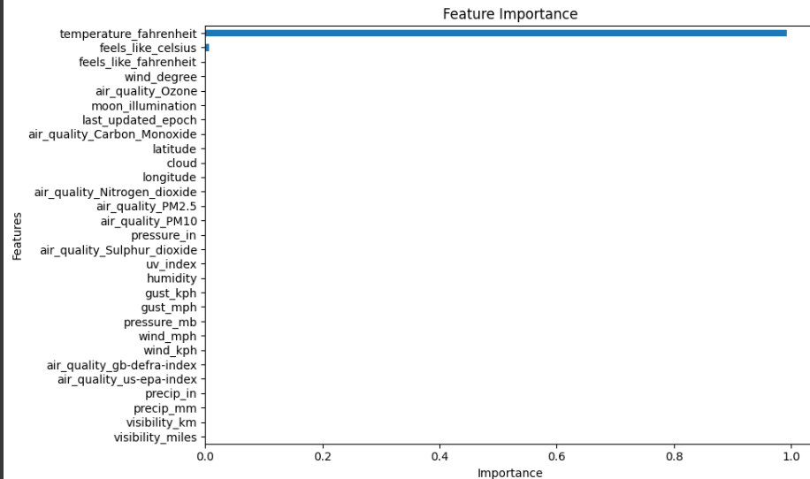
FEATURE IMPORTANCE:

Slide 16
Why Linear Regression Stood Out as the Best Model
Linear Regression performed the best because it matched the characteristics of the dataset:
Perfect Fit for the Data:
The data showed a straightforward linear relationship between features and temperature, making Linear Regression an excellent match.
Models like ARIMA and SARIMA are great for time-series data with strong seasonality, but that wasn’t a dominant factor here.
Simple and Efficient:
Linear Regression is easy to implement and doesn’t require complex configurations, making it both time-efficient and practical.
It avoids unnecessary complexity, unlike ensemble models or time-series models that require significant tuning.

Slide 17
Why Linear Regression Stood Out as the Best Model
3. Most Accurate Predictions:
With the lowest error (MAE of 0.0933), Linear Regression provided the most reliable results compared to other models.
4. Balanced Performance:
Other models like SARIMA or Ensemble methods are powerful but added complexity without significantly improving accuracy.
Linear Regression struck the perfect balance between simplicity and performance.
In Summary:
Linear Regression is the best choice for this dataset because it’s accurate, efficient, and easy to use, making it ideal for real-time forecasting tasks.

Slide 18
INSIGHTS:
Linear Regression emerged as the most accurate and reliable model for predicting temperature,
especially for linear trends in the data.
Spatial Analysis revealed how climate varies significantly across different regions, highlighting
important geographical patterns.
Air Quality showed strong correlations with temperature and humidity, offering insights into
environmental impacts.
Feature Importance analysis identified actionable predictors like humidity and air quality metrics,
which play a significant role in temperature changes.

Slide 19
SuBMISSION:
Contains all code, analyses, visualizations, and results.
Includes a detailed README.md explaining:
Project objectives.
Methodology.
Results and insights
LINK TO GITHUB

